Slide 1
A Journey with Data
-Data Module 2
BNU-HKBU
United International College

Slide 2
Outline
Four-Evolution Stages of Data
Bit and Byte
Binary system
Data representation

Slide 3

Data, Info, Knowledge and Insight (DIKI)
Raw data is seldom useful. It must undergo a transformation to become useful.
Data → Information → Knowledge → Insight(Wisdom)
These terms seem similar, but how are they different?

Slide 4
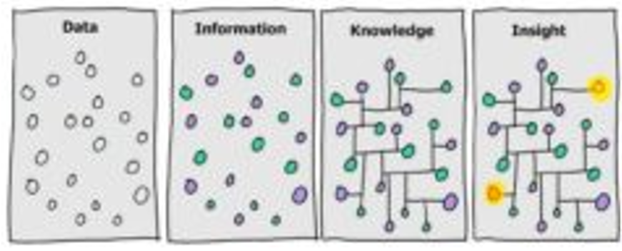
Four-Evolution Stages
These terms can be explained with a 4-stage box.
  Some people consider Wisdom instead of insight or add Wisdom as the 5th stage.
Data, or raw data, are numbers or things that can represented as numbers.
  In the diagram, data is represented by a bunch of seemingly random dots.
Information includes the relationship between the dots.
  In the diagram, related dots have the same color.

Slide 5
Four-Evolution Stages
Knowledge is gained when we make connections between the different pieces of information.
  In the diagram, the dots are connected.
Insight(Wisdom) is gained when we synthesize (put together) knowledge to make the data useful.
  We use insight to solve a problem or make a business decision.
Ref. DIKW pyramid (Video Clip)

Slide 6
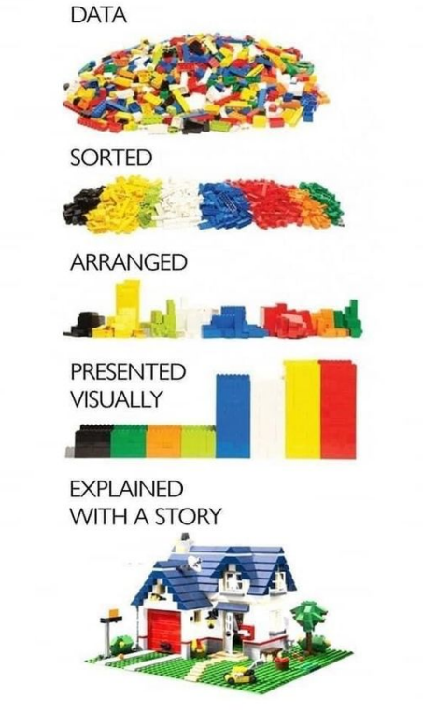
Another Picture for DIKI
A bunch of lego blocks can be turned into a house.
Do you think more blocks always better to build something?
Or Is more variety of
blocks better?

Slide 7
Four-Evolution Stages
Our journey starts with understanding how DATA is represented on a computer.
Remark:
It’s customary for computer people to use binary or hexadecimal numbers.
You will see binary or hexadecimal numbers in some of the following charts.
Don’t worry about those hex numbers if you don’t have 16 fingers. The corresponding base 10 numbers are also shown.

Slide 8
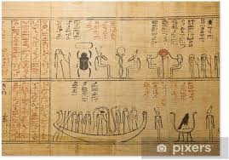

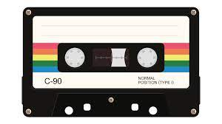
Types of Data
Analog data :
Stored in a physical way.
Papyrus, Note and Pencil and Magnetic cassette tape…etc.

Slide 9
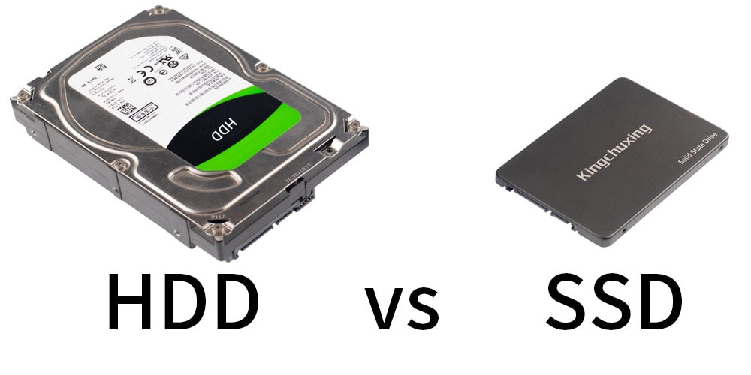
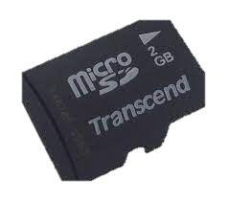
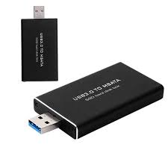
Types of Data
Digital data
Data in binary code (0011, 00000011…)
  Structured(number) data
  Unstructured data
  - text/image/sound…
  Electronic data
  Where are they?
We focus on digital
data in this class

Slide 10
Binary Number System
Binary number system is also called
  base-2 number system
  as a language for computers(digital devices)
Questions
  What is decimal number of (10)₂?
  What is binary number of 3 ?

Slide 11
Binary Number System
Binary number system has only two digits
  0, 1
Counting in binary system
  0, 1, 10, 11, 100, 101, 110, 111, 1000,….
Binary number in expanded notation
(101)₂ = 1×2² + 0×2¹ + 1×2⁰ = (5)₁₀

Slide 12
Why Binary?
A computer is a binary machine.
  It knows only 1 and 0.
  1 and 0 are represented by states on and off (high and low voltages) of a computer circuit.
Binary number system is used in computers because it is:
  easy to implement in electronic circuits;
  reliable;
  cheap.

Slide 13
Bit and Byte (unit of data)
Bit stands for binary digit
  A single digit 0 or a single digit 1.
  The smallest possible unit of information.
1 byte = 8 bits.
1 byte is just big enough to store one English character from a standard US keyboard.
Normally, 5MB means 5 mega bytes and
5Mb means 1 mega bits

Slide 14
Size of Data
Measure units of size
  Kilo 1K = 2¹⁰ = 1024 ≈ 10³
  Mega 1M = 2²⁰ = 1,048,576 ≈ 10⁶
  Giga 1G = 2³⁰ = 1,073,741,824 ≈ 10⁹
  Tera 1T = 2⁴⁰ = 1,099,511,627,776 ≈ 10¹²
  Example:
    The bandwidth (speed) of a WiFi network could be 20 Mbps (megabits per second).

Slide 15
Bit and Byte
Example:
    A file's size could be 10KB (kilobytes).
    A USB thumb drive's capacity could be 16GB (gigabytes).
      In other words, the USB thumb drive can store a maximum of about 16 billion English characters.

Slide 16
Representing Text in a Computer
A text document can be decomposed into chapters, paragraphs, sentences, words, and ultimately, individual characters.
Types of characters need to be represented:
  “a, b, c, d, … ”
  “1, 2, 3, 4, …”
  “+, -, *, /, …”
  “高, 天, 孤, 月, …”
The general approach is to assign each character a binary code:
  Binary code are 0’s and 1’s, which the computer can process.
  ‘a’ → (01100001)₂ → 97
  So in decimal (base 10), ‘a’ has a code value of 97, ‘b’ has code value 98, ‘c’ has code value _____ , … ,

Slide 17

Representing Text Data
f
code value
102
Which of us is happy in this world? Which of us has desire? Or, having it, is satisfied?
-William Makepeace Thackeray, Vanity
comma
code value
44

Slide 18
Character Set
A character set is a mapping between characters and binary codes used for representing them.
A character set defines how to represent text in a computer.
Many character sets exist:
  ASCII
  Unicode

Slide 19
ASCII Character Set
ASCII stands for American Standard Code for Information Interchange.
  Designed for English only.
Uses exactly 8 bits to represent a character.
  Can represent 2⁸ = 256 characters, enough for English
Not enough for international languages:
  Chinese
  Thai
  ……

Slide 20
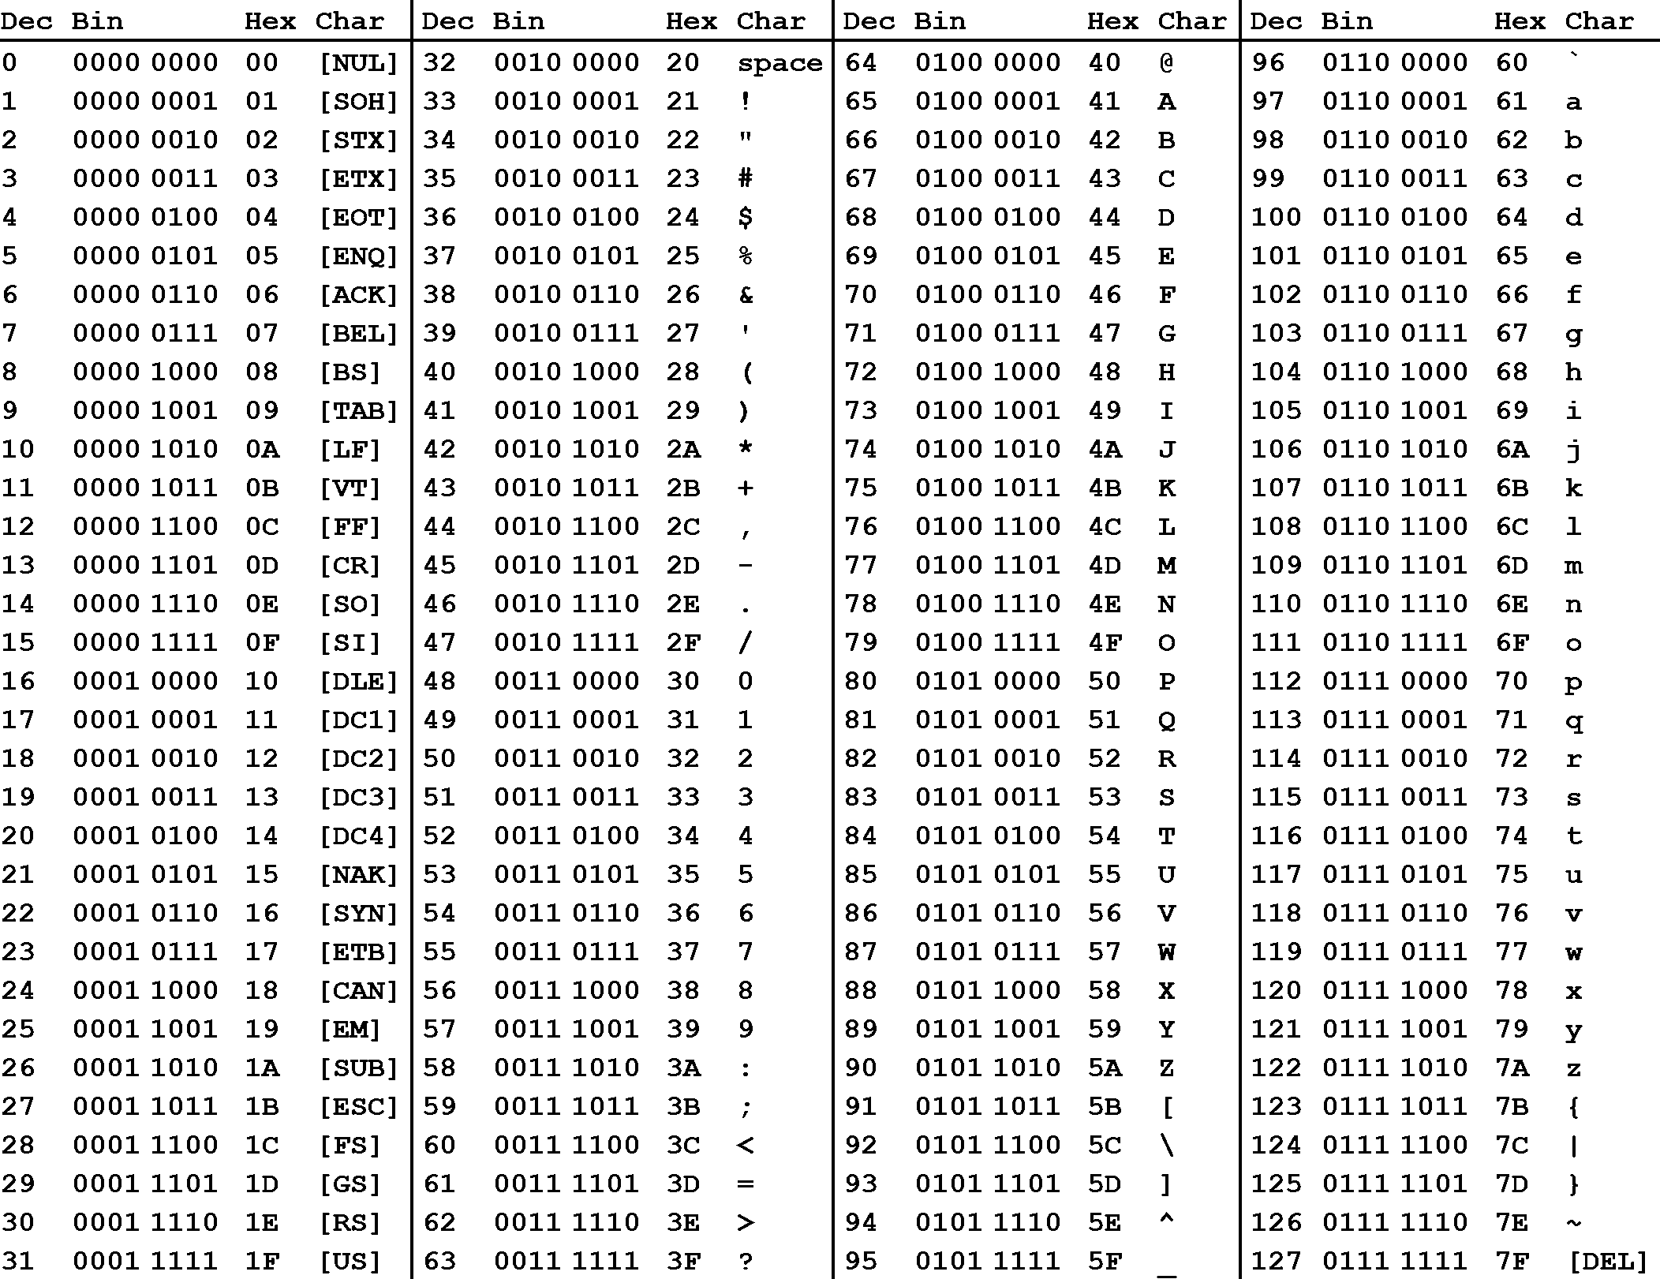
Basic ASCII
Decimal (base 10) values are in the ‘Dec’ column; see the blue arrows.
Verify that ‘a’ has code value 97; see the red arrow.

Slide 21
Basic ASCII
Basic ASCII
  Contains the first 128 characters in ASCII.
  Is half of the ASCII table.
The first 32 characters of basic ASCII are control characters that cannot be displayed on the screen: backspace, escape, etc.

Slide 22
Unicode Character Set
Uses 8 to 32 bits to represent a character.
  Number of bits used depends on the character.
Over 137,000 characters are defined so far.
  Over a million characters possible if necessary.
Supports all human languages, including Chinese.
Designed as a superset of basic ASCII.
  The first 128 characters in Unicode correspond exactly to those in basic ASCII.

Slide 23
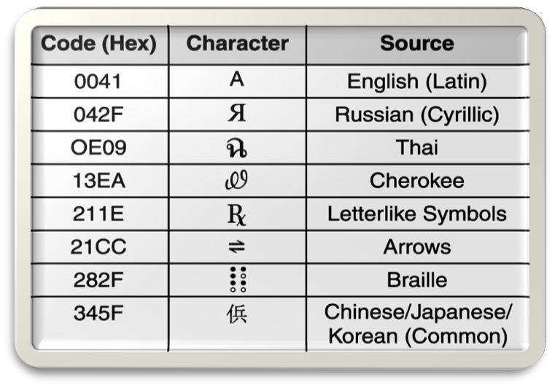
Unicode Character Set
https://www.unicode.org/charts/
Now we know how text data is represented in the computer, then how about sound and image data?

Slide 24
Representing Audio Data
We perceive sound when a series of air compressions vibrate a membrane in our ear sending signals to our brain.
The microphone is responsible for converting changes in sound pressure to changes in electric signal.
  This signal is an analog representation of the sound wave.
  The voltage in the signal varies in direct proportion to the sound wave.

Slide 25
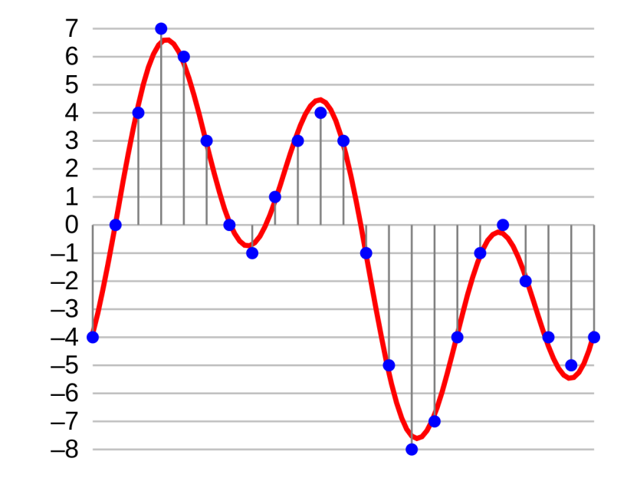
Representing Audio Data
To digitize the signal we periodically measure the voltage of the signal and record the appropriate numeric value.
  A process called sampling.
In general, a sampling rate of around 40,000 times per second is enough to create a perfect sound reproduction.
Notes:
https://upload.wikimedia.org/wikipedia/commons/thumb/2/21/4-bit-linear-PCM.svg/1280px-4-bit-linear-PCM.svg.png

Slide 26
Representing Color for image data
The RGB (red green blue) color model
  Is one of the most common ways to encode color in computing.
  Represents every color using a combination of three colors: red, green, and blue.
  Uses an integer number to represent the contribution of each color, respectively.
  Refers to the three primary colors of light.

Slide 27




RGB Color Model
True Color representation.
  Uses 8 bits to represent each single
  primary color in the order of RGB.
  The integer numbers are in the range 0 to 255. Often represented as either decimal or hexadecimal (base 16) numbers.
D5F99F
  Represented as (213, 249, 159) in decimal numbers.
Red
Green
Blue

Slide 28
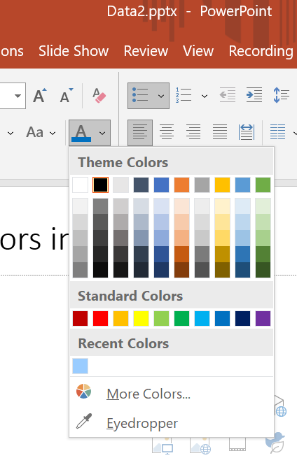
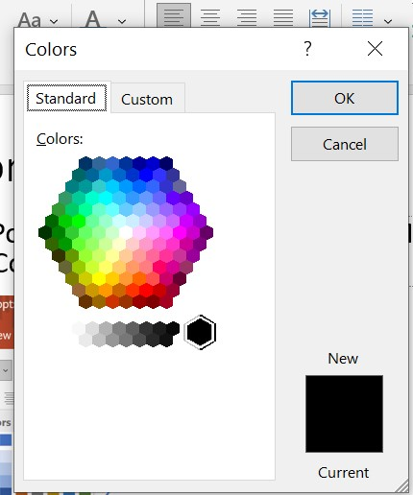
Mix Colors in PowerPoint
1. In PowerPoint, select the Font Color.
2. Select More Colors, then select Custom

Slide 29
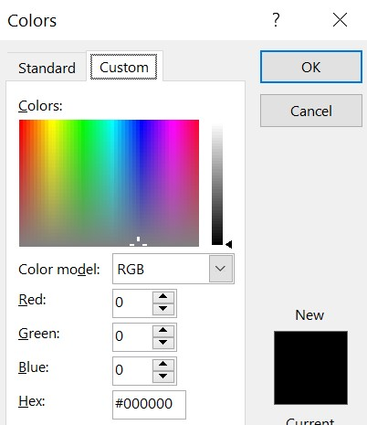
Mix Colors in PowerPoint
Enter values for Red, Green and Blue.
Try these values:
  (255, 0, 0) Full red, no green, no blue
  (255, 0, 255) Full red, no green, full blue
  What do you get with full red, full green and full blue?

Slide 30
Digitizing Images
An image is divided into individual dots called pixels (picture elements).
  A pixel is the smallest unit in a picture.
  A pixel contains a single color.
Image information is stored on a pixel-by-pixel basis.
  The color for each pixel is recorded.
  Related formats: BMP, GIF, PNG and JPEG
Next slide is a bitmap (BMP) image of a robot.
  The color of the arm is (7, 156, 144)

Slide 31

BMP
Pixel on the arm:
  (7, 156, 144)

Slide 32

Bitmap Image (BMP)
The bitmap of the robot can be represented by a series of number representing the color of each pixel, starting from top row, going from left to right.
  Suppose the top left pixel is (197, 181, 113)
  The color of the hair is (0, 0, 0).
  The color for the arm pixel is (7, 156, 144).
Then the bitmap image is represented as 197, 181, 113, … 0, 0, 0, … 7, 156, 144 …
  List the pixel values, from top row downward, going from left to right.

Slide 33
Image Resolution
Resolution refers to the number of pixels in an image.
  Resolution determines how much detail an image contains.
Resolution is usually quoted as width × height, with the units in pixels.
  1024 × 768, for a typical computer screen.
  iPhone X has 2436 × 1125 = 2.7 mega (2.7 million) pixels
    Check out how many megapixels in your cell phone.
Let’s assume the resolution for the robot image is 60 × 40.
  Each row has 60 pixels, each column has 40 pixels.

Slide 34
Exercise
Are the following tables data, information, knowledge or insight?
Table 1 | Apple | Kiwi |  | Table 2 | My Snack
 | Banana | Cherry |  |  | Monday | Cherry
 | Melon | Orange |  |  | Tuesday | Apple
 | Grape | Lemon |  |  | Wednesday | Grape
 | Papaya | Plum |  |  | Thursday | Apple
 | Pineapple | Avocado |  |  | Friday | Apple
 | Mango | LyChee

Slide 35
Summary of Data Moudle
Definition and types of data
Interesting history of Data
Data and ICT Technologies
Four-Evolution Stages (Data, Information, Knowledge and Insight)
Bit and Byte
Binary System and Data representation.
Notes:
<number><number><number><number>

